Slide 1

Other Quality Attributes
Teacher: Huang wu
2019/10/22 Chengdu

Slide 2
Outline
Usability
Other Quality Attributes
70

Slide 3
Usability Outline
Introduction
Usability General Scenario
Tactics for Usability
A Design Checklist for Usability
Summary
70

Slide 4

1. Introduction
Any darn fool can make something complex, it takes a genius to make something simple.
——Albert Einstein
70

Slide 5
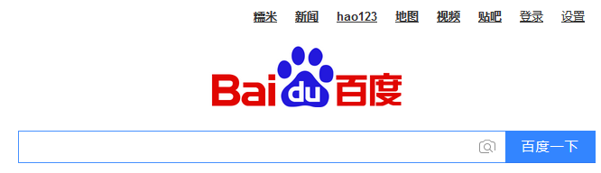
1.1 Concept of Usability
Usability is concerned with how easy it is for the user to accomplish a desired task and the kind of user support the system provides
Usability is the cheapest and easiest ways to improve a system quality.
70

Slide 6
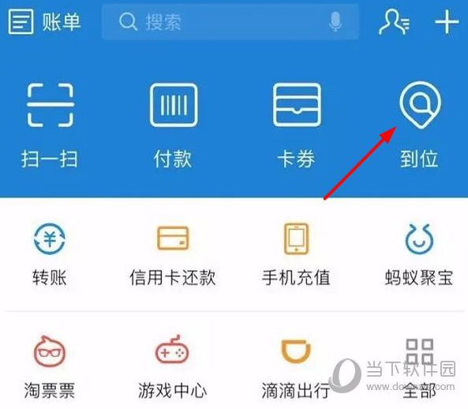
Discuss
How do you realize usability for your software?
70

Slide 7

1.2 What Does Comprise the Usability
Usability comprises the following areas:
Learning system features
Using a system efficiently
Minimizing the impact of errors
Adapting the system to user needs
Increasing confidence and satisfaction
70

Slide 8


2. Usability General Scenario
General scenario of usability with parameters
Artifact:
System
Specific portion
Stimulus:
Response：
End user satisfaction
Satisfy the End User
Response measure：
Source:
Environment:
End user
Runtime
Configuration Time
Task Time
Number of Error
…
70

Slide 9
2.1 General Quality-Attribute Table of Usability
Portion of Scenario | Possible Value
Source | End user, possibly in a specialized role
Stimulus | End user tries to use a system efficiently, learn to use the system, minimize the impact of error, adapt the system
Artifact | System or the specific portion of the system with which the user is interacting
Environment | Runtime or configuration time
Response | The system should either provide the user with the features needed
Response Measure | Task time, number of errors, number of tasks accomplished, user satisfaction, gain of user knowledge, ratio of successful operations to total operations
70

Slide 10
2.2 A Concrete Scenario of Usability
Artifact:
System
Response：
Stimulus:
Downloads a New Application
User Uses Application Productively
Response measure：
Source:
Environment:
Users
Runtime
Within Two Minutes of Experimentation
The user downloads a new application and is using it productively after two minutes of experimentation
70

Slide 11
3. Tactics for Usability
The goal of runtime usability tactics is for the user to accomplish a desired task
User Given Appropriate Feedback and Assistance
Tactics to Control Usability
User Request
70

Slide 12
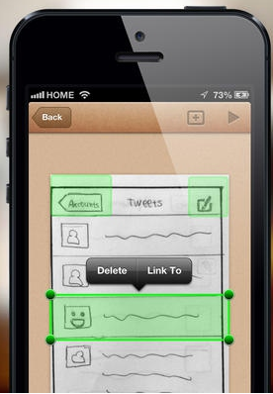
3.1 Separate the User Interface
Architect make a system usable to facilitate experimentation with the user interface via the construction of rapid prototypes
Building several prototypes to let real users experience the interface and give their feedback
The best way to do this is to design the software so the user interface can be quickly changed
70

Slide 13
3.1.1 How to Separate Interface
Increase semantic coherence, encapsulate, and co-locate related responsibilities, which localize user interface responsibilities
Restrict dependencies, which minimizes the ripple effect to other software when the user interface changes
Defer binding, which lets you make critical user interface choices
70

Slide 14
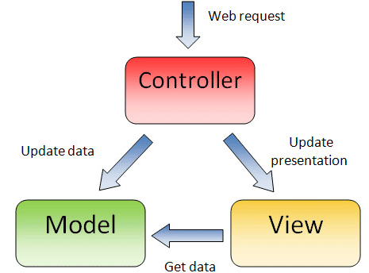
3.1.2 Example of Separate Interface
Much work in different user interface separation patterns occurred in the 1980s and 90s
MVC is a dominant separation pattern
70

Slide 15
4.2 Two categories of Usability Tactics
User Initiative
User initiative a request and the system feedback the processing
System Initiative
System maintain the user model, it actively responses the user request
70

Slide 16
4.2.1 The Graph of Classifying Usability Tactics
Usability
Support User Initiative
Support System Initiative
User Given Appropriate Feedback and Assistance
User Request
Cancel
Undo
Pause/Resume
Aggregate
Maintain Task Model
Maintain User Model
Maintain System Model
Usability tactics
70

Slide 17
4.3 Support User Initiative
Once a system is executing, usability is enhanced by giving the user feedback as to what the system is doing and by allowing the user to make appropriate responses
User initiative tactics:
Cancel
Undo
Pause/resume
Aggregate
70

Slide 18

4.3.1 Cancel
Cancel: When the user issues a cancel command, the system must be listening for it，cancel includes:
The command being canceled must be terminated
Any resources being used by the canceled command must be freed
Components that are collaborating with the canceled command must be informed so that they take action.
70

Slide 19

4.3.2 Undo
Undo: To support the ability to undo, the system must maintain a sufficient amount of information about system state so that an earlier state may be restored, at the user’s request
Not all operations can be easily reversed, for example, launch the rocket
70

Slide 20
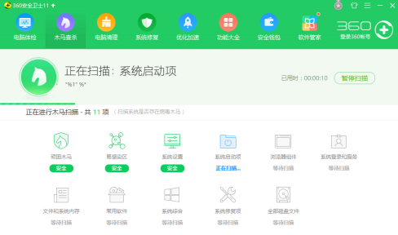
4.3.3 Pause/Resume
Pause/Resume：When a user has initiated a long-running operation, it is often useful to provide the ability to pause and resume the operation
Effectively pausing a long-running operation requires the ability to temporarily free resources so that they may be reallocated to other tasks
70

Slide 21
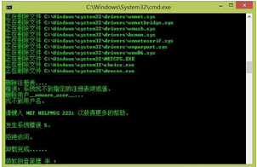
4.3.4 Aggregate
Aggregate: When a user is performing repetitive operations, or operations that affect a large number of objects in the same way, it is useful to provide the ability to aggregate the lower-level objects into a single group, so that the operation may be applied to the group
Aggregate like the batch file
70

Slide 22
4.4 Support System Initiative
The system initiative rely on a model of the user
Each model requires various types of input to accomplish its initiative
The support system initiative tactics are those that identify the models the system uses to predict either its own behavior or the user’s intention
70

Slide 23
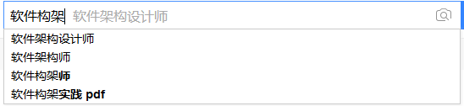
4.4.1 Maintain Task Model
Maintain task model
The task model is used to determine context so the system can have some idea of what the user is attempting and provide assistance
70

Slide 24

4.4.2 Maintain User Model
Maintain user model:
This model explicitly represents the user’s knowledge of the system, the user’s behavior in terms of expected response time, and other aspects specific to a user or a class of users
70

Slide 25
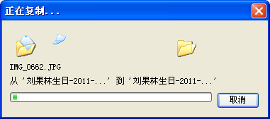
4.4.3 Maintain System Model
Maintain system model
System maintains an explicit model of itself, This is used to determine expected system behavior so that appropriate feedback can be given to the user.
70

Slide 26
4.5 Summary Usability Tactics
Usability
Support User Initiative
Support System Initiative
User Given Appropriate Feedback and Assistance
User Request
Cancel
Undo
Pause/Resume
Aggregate
Maintain Task Model
Maintain User Model
Maintain System Model
Usability tactics
70

Slide 27
4. A Design for Usability
The design for Usability include:
Allocation of responsibilities
Coordination model
Data model
Mapping among architectural elements
Resource management
Binding time
Choice of technology
70

Slide 28
4.1 Allocation of Responsibilities
Ensure that additional system responsibilities have been allocated
Learning how to use the system
Efficiently achieving the task at hand
Adapting and configuring the system
Recovering from user and system errors
70

Slide 29

4.2 Coordination Model
Determine the properties of system elements’ coordination，Affect how
A user learns to use the system
Achieves goals or completes tasks
Adapts and configures the system
Recovers from user and system errors, and gains increased confidence and satisfaction
70

Slide 30
4.3 Data Model
Determine the major data abstractions that are involved with user-perceivable behavior
Ensure these major data abstractions have been designed to satisfy the user’s operation
For example, maintain the old state data for undo command, maintain the user model etc.
70

Slide 31
4.4 Mapping among Architectural Elements
Determine what mapping among architectural elements is visible to the end user
For example, the extent to which the end user is aware of which services are local and which are remote
70

Slide 32
4.5 Resource Management
Determine how the user can adapt and configure the system’s use of resources
Ensure that resource limitations under all user-controlled configurations will not make users less likely to achieve their task
Ensure that the level of resources will not affect the users’ ability to operate
70

Slide 33
4.6 Binding Time
Determine which binding time decisions should be under user control
Ensure that users can make decisions that aid in usability
For example, if the user can choose, at runtime, the system’s configuration, or its communication protocols, or its functionality via plug-ins, you need to ensure that choice do not affect the user
70

Slide 34
4.7 Choice of Technology
Ensure the chosen technologies help to achieve the usability scenarios that apply to your system
For example, do these technologies aid in the creation of online help, the production of training materials, and the collection of user feedback
70

Slide 35
View
Concept
Express
Realize
Quality attributes
Scenarios
Usability
Design Check List
Realize
Tactics
Cancel
Undo
Pause
Integrate
Include
Task model
User model
System
model
User initiative
System initiative
70

Slide 36
5. Summary
Architectural support for usability involves both user initiative or the system initiative
To be able to predict user or system responses, the system keeps and explicit model of the user, system and task
There is a strong relationship between supporting the user interface design process and supporting modifiability
70

Slide 37
Other Quality Attributes Outline
Other Important Quality Attributes
Other Categories of Quality Attributes
Using Standard List of Quality Attributes
Dealing with “X-ability” Attributes
70

Slide 38
1. Other Important Quality Attributes
Besides the seven main quality attributes, there are some others
Variability
Portability
Development distributability
Scalability (elasticity)
Deployability
Mobility
Monitorability
70

Slide 39
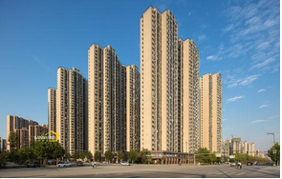

1.1 Variability
Variability is a special form of modifiability
It refer to the ability of a system and its supporting artifacts such as requirements, test plans, and configuration specifications to support the production of a set of variants that differ from each other in a preplanned fashion
70

Slide 40

1.1.1 Variability Utility
Variability is used in the software product line
Product line means the ability of a core asset to adapt to usages in the different product contexts that are within the product line scope
70

Slide 41

1.2 Portability
Portability is a special form of modifiability
It refer to the ease with which software that was built to run on one platform can be changed to run on a different platform
70

Slide 42
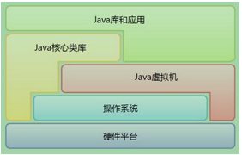
1.2.1 Portability Realization
Portability is achieved by minimizing platform dependencies in the software, isolating dependencies to well-identified locations, and writing the software to run on a “virtual machine”
Virtual machine such
as Java VM or the HTML5 language
70

Slide 43
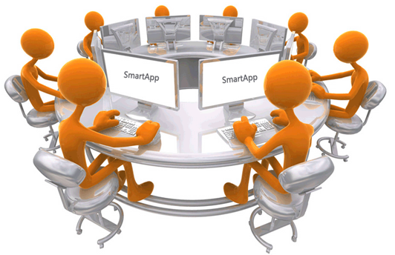
1.3 Development Distributability
Development distributability is the quality of designing the software to support distributed software development
Many systems these days are developed using globally distributed teams
70

Slide 44
1.3.1 Development Distributability Realization
Distributed development must overcome the coordination problems
The system should be designed so that coordination among teams is minimized
The minimal coordination needs to be achieved both for the code and for the data model
70

Slide 45

1.4 Scalability
Scalability is a special form of modifiability
Two kinds of scalability
Horizontal scalability refers to adding more resources to logical units, such as adding another server to a cluster of servers.
Vertical Salability refers to adding more resources to a physical unit, such as adding more memory to a single computer
70

Slide 46
1.4.1 Scalability Realization
The scalability must solve how to effectively utilize the additional resources
Being effective means additional resources result in a measurable improvement of system quality, did not require undue effort to add, and did not disrupt operations
70

Slide 47

1.4.2 Elasticity
In cloud environments, horizontal scalability is called elasticity
Elasticity is a property that enables a customer to add or remove virtual machines from the resource pool
These virtual machines are hosted on a large collection of upwards of 10,000 physical machines that are managed by the cloud provider
70

Slide 48
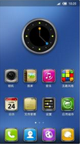
1.5 Deployability
Deployability is concerned with how an executable arrives at a host platform and how it is subsequently invoked
Deployment scenarios will deal with the type of update (push or pull), the form of the update (medium, such as DVD or internet download), the resulting integration into existing system, the efficiency of the process, and the risk
70

Slide 49
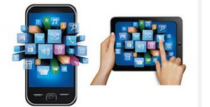
1.6 Mobility
Mobility deals with the problems of movement and affordances of a platform(e.g. size, type of display, type of input devices, availability and volume of bandwidth, and battery life)
70

Slide 50

1.6.1 Mobility Issues
Issues in mobility include:
Battery management
Reconnecting after a period of disconnection
The number of different user interfaces necessary to support multiple platforms
70

Slide 51
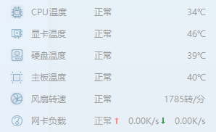
1.7 Monitorability
Monitorability deals with the ability of the operations staff to monitor the system while it is executing
Monitor software internal states such as the queue lengths, average transaction processing time, and the health of various components
Question: What quality attribute does this quality attribute belong to ?
70

Slide 52
2. Other Categories of Quality Attributes
Except to the product qualities, there are some other types of quality attributes that measure goodness of something other than the final product:
Conceptual integrity of the architecture
Quality in Use
Marketability
70

Slide 53


2.1 Conceptual Integrity of the Architecture
Conceptual integrity refers to consistency in the design of the architecture, and it contributes to the understandability of the architecture and leads to fewer errors of confusion
Conceptual integrity demands that the same thing is done in the same way through the architecture
70

Slide 54
2.1.1 Less is more
In an architecture with conceptual integrity, less is more
For example, there are countless ways that components can send information to each other: messages, data structures, signaling of events, and so forth. However, using one way only
Components should all report and handle errors in the same way
70

Slide 55
2.2 Quality in Use
Some quality in use are as follows:
Effectiveness: building the system correctly(requirements) and building the correct system(user wishes)
Efficiency: the effort and time required to develop a system
Freedom from risk: The degree to which a product or system affects economic status, human life, health etc.
70

Slide 56
2.3 Marketablity
Some systems are well know by their architectures, and these architectures sometimes carry a meaning all their own
The current craze in building cloud-based systems has taught us that the perception of an architecture can be more important than the qualities the architecture brings
70

Slide 57
3. Using Standard Lists of Quality Attributes-or Not
The standard is “ISO/IEC FCD 25010: Systems and software engineering—System and software product Quality Requirements and Evaluation—System and software quality models”
70

Slide 58
3.1 The Standard List (1/3)
The standard lists the following quality attributes:
Functional suitability (Functional completeness, Correctness and Appropriateness)
Performance efficiency (Time behavior, Resource utilization and capacity)
Compatibility ( Coexistence Interoperability)
70

Slide 59
3.2 The Standard List (2/3)
Usability ( Appropriateness recognizability, Learnability, Operability, User error prediction, User interface aesthetics, Accessibility)
Reliability (Maturity, Availability, Fault tolerance, Recoverability)
Portability (Adaptability, Installability, Replaceability)
70

Slide 60
3.3 The Standard List (3/3)
Security (Confidentiality, Integrity, Nonrepudiation, Accountability, Authenticity)
Maintainability (Modularity, Reusability, Analyzability, Modifiability, Testability)
Page 194
70

Slide 61
4. Dealing with “X-ability”: Bringing a New Quality Attribute
Suppose, as an architect, you must deal with a quality attribute for which there is no compact body of knowledge, such as “ green computing” or “manageability”，or Intelligenciability
How do we deal with the unknown quality attributes
70

Slide 62
4.1 Deal With the Unknown Quality Attributes
Capture scenarios for the new quality attributes
Assemble design approaches for the new quality attribute
Model the new quality Attribute
Assemble a set of tactics for the new quality attribute
Construct design checklists for the new quality attribute
70

Slide 63
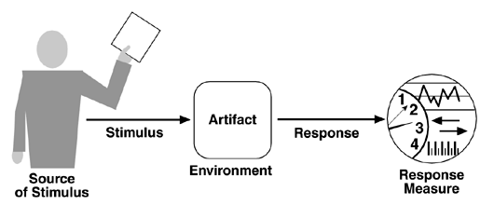
4.1.1 Capture Scenarios
Capture scenarios by interviewing the stakeholders to build a set of attribute characterizations
Once you have a set of specific scenarios, then you can work to generalize the collection. Look at the set of stimuli, the responses, the response measures, and so on
70

Slide 64

4.1.2 Assemble Design Approaches
Assemble design approaches is:
Revisiting a body of design patterns
Searching for designs that have had to deal with this QA
Finding experts in this area and interviewing them
Using the general scenario to try to catalog a list of design approaches
Using the general scenario to catalog a list of way in which a problematic architecture would fail to responses
70

Slide 65

4.1.3 Model the New QA
If you can build a conceptual model of the quality attribute, this can be helpful in creating a set of design approaches for it
By model, we don’t mean anything more than understanding the set of parameters to which the quality attribute is sensitive
70

Slide 66
4.1.4 Assemble a Set of Tactics
There are two sources that can be sued to derive tactics for any quality attribute:
Model: enumerate the parameter of the model, for each parameter, enumerate the architectural decision (tactic)
Experts: Interview experts in the field then summarize
70

Slide 67
4.1.5 Construct Design Checklists
Finally, examine the seven categories of design decision and ask yourself how to specialize your new quality of interest to these categories
Reviewing a software architecture and trying to figure out how well it satisfies your new qualities in these seven categories
70

Slide 68
View
1. Quality attributes
2. Quality Type
Architectural
Other
quality attributes
Other categories
of quality attributes
Include
Quality in use
Variability
Portability
Scalability
Deployability
Mobility
Monitorability
Safety
…
Marketability
3. Extend quality attributes
Model
Dealing with
X-ability
Standard lists
of quality attributes
Experts
70

Slide 69
Homework
Write a set of concrete scenarios for usability using each of the possible responses in the general scenario
How might usability trade off against performance
Specify the data model for a four-function calculator that allows undo
70

Slide 70
Discuss
Security and usability are often seen to be at odds with each other. Security often imposes procedures and processes that seem like needless overhead to the casual user. But some say that security and usability go hand in hand and argue that making the system easy to use securely.
How do you coordinate the security and the usability?
70

